Slide 1
C# Methods –
Outline
  Program structure
  Divide and Conquer
  Method Types
    Predefined
    User-defined
  Examples

Slide 2
Simple C# Structure
Review condition statement
Namespace
  Class
    Main()
Namespace
Class
Main()
Variable & Constant Location
statements
WriteLine, ReadLine, if, switch, Loop
<number>/25

Slide 3
C# Structure – Multiple Methods
Namespace
Class
Main()
Method1()
Method2()
Method3()
MethodNN()
<number>/25

Slide 4
What is a Method
A method is an operation that a program can perform
Best that a method is perform a single function
<number>/25

Slide 5
Why ?
“Divide and conquer” – allows us manage complexity and realise our design ideas
Reduces duplication of code
  Allows for reuse
Easier to maintain
Easier to test
Team programming
<number>/25

Slide 6
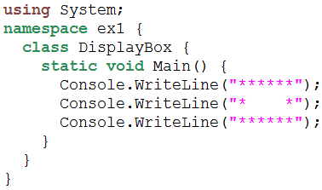
Method in C#
“Method is a function owned by your class.”
<number>/25

Slide 7
Method Types
Method Type
Predefined
Method
User-defined
Method
Return
value
No return
value
Return
value
No return
value
<number>/25

Slide 8
Predefined Method Example
Method → Return no value
  Console.WriteLine(”Island”);
  Console.Write(”Matrix”);
  …
Method → Return value, i.e. The method sends a value back to the method that called it.
  string st=Console.ReadLine();
  int x=Convert.ToInt32(”123”);
  int y=Math.Pow(2, 3);
<number>/25

Slide 9
Method Types
Method Type
Predefined
Method
User-defined
Method
Return
value
No return
value
Return
value
No return
value
<number>/25

Slide 10
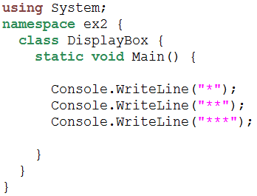
Method Example 1
static void Display() {
…
…
}
<number>/25

Slide 11
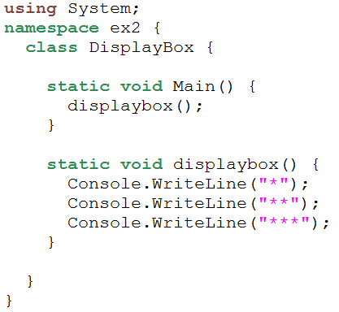
Method Example 1
0
4
1
3
2
<number>/25

Slide 12
C# Structure - Methods
Namespace
Class
Main()
Variable & Constant Location
statements
Method1()
Variable & Constant
statements
MethodX()
Variable & Constant
statements
<number>/25

Slide 13
Outline
C# Review
Method in C#
  Declaration
  Examples
<number>/25

Slide 14
The basic syntax of coding a method
[static] [public|private] return-type Methodname ([parameter list])
{
[const/variable declaration];
[statements];
}
<number>/25

Slide 15
Syntax Description
static
  Method can be referred to directly from a class
public | private
  These are access modifers, you’ll use the private access modifier so the method can only be called from within the class where it is coded
  you’ll use the public access modifier when you want to allow the method to be called from another the class
<number>/25

Slide 16
Syntax Description(1)
return-type can be
  a data type like int, double, string, etc. When a return type is specidied, a return statement must be include in the method body. This ends the execution of the current method and returns the specified value to the calling method
  the keyword void , this is used when the metodh does not return data.
Method name
  Use identifier naming rules
<number>/25

Slide 17
Syntax Description(2)
Parameter list
  Within the parenthesis of a method, you can code an optional parameter list, this is data that the method is receiving
The name and parameter list for the signature of the method
<number>/25

Slide 18
Method Declaration Example
static void displaybox() {
}
static string calgrade(int score) {
}
<number>/25

Slide 19
Calling a method
With no return value:
  DisplayStars();
  DisplayAge(string name, int age);
With a return value (use as you would a variable)
  double area = CalcArea(double width, double high);
  Console.WriteLine(CalcArea(double width, double high));
  If (CalcArea(double width, double high) > 20)….
<number>/25

Slide 20
How to send value into Method?
Use class level variables
  Easy to implement
Using Method’s Parameter
  Generally it is a good idea that modules are independent of each other and therefore easier to maintain
  as it encourages the design notions of encapsulation and information hiding which lead to loosely coupled systems -
<number>/25

Slide 21
Class Level Variable
Namespace
Class
Private(class)/Public Variable & Constant
Main()
Local Variable & Constant
statements
Method1()
Local Variable & Constant
statements
MethodX()
Local Variable & Constant
statements
<number>/25

Slide 22
Example: Class level variable
class Program
{
  int n ; // n can be used by all methods
static void Main(string[] args)
{
n = 7;
Console.WriteLine(n);
TestMethod(); // passing copy of value in n to called method
Console.WriteLine(n);
}
static void TestMethod()
{
Console.WriteLine(n);
n = 5;
Console.WriteLine(n);
}
}
<number>/25

Slide 23
Calling a Method with a parameter list
When you call a method, you code an argument list with the arguments that are passed to the method, (this may be empty, if corresponding parameter list is empty also)
The arguments you pass to a method must have data types that are compatible with their corresponding parameters. However, the names do not have to match
The arguments list must be in the same order as the parameter list.
<number>/25

Slide 24
Method with parameters Declaration Example
static int calArea(int x,y;) {
}
A method with two parameters
<number>/25

Slide 25
Method Idea
width
high
name
age
CalArea
DispAge
area
Return Value
Return no value
(void)
<number>/25

Slide 26
Example Passing agruments(1)
class Program
{
*************
static void Main(string[] args)
{
int n; // can only be used in Main method
n = 7;
Console.WriteLine(n); // n is refered to as an argument
TestMethod(n); // passing copy of value in n to called method
Console.WriteLine(n); // n will still be 7
}
static void TestMethod(int y) // y is refered to as a parameter
{
Console.WriteLine(y);
y = 5;
Console.WriteLine(y);
}
}
<number>/25

Slide 27
Example Passing agruments(2)
class Program
{
*************
static void Main(string[] args)
{
int width, height; // can only be used in Main method
width = 7;
height = 10;
int area = CalcArea(width,height); // passing copy of value in n to called method
Console.WriteLine(area);
}
static int CalArea(int x, y) // y is refered to as a parameter
{
int a = x * y;
return a;
}
}
<number>/25

Slide 28
When and how to Pass arguments by reference and by value
By default the arguments that are passed to a method are passed by value.
That means that the value of each passed variable is assigned to the corresponding parameter in the method.(a copy of calling methods variable is passed to called methods parameter).
Because of this, any change made to the parameter in the called method, DO NOT affect the variable in the calling method
In some cases, though, you’ll want to change the value of the variable in the calling method from the called method
To do this, you pass the argument by reference
Here the ref keyword is code before the argument and before the parameter declaration
The out keyword causes arguments also to be passed by reference. This is like the ref keyword, except that ref requires that the variable be initialized before it is passed. To use an out parameter, both the method definition and the calling method must explicitly use the out keyword.
<number>/25

Slide 29
Pass by Reference
Here a reference(address) of calling methods variable is passed to called method.
Any change made in the called method WILL affect the variable in the calling method
<number>/25

Slide 30
Example Pass by reference
class Program
{
static void Main(string[] args)
{
int n;
n = 7;
Console.WriteLine(n);
TestMethod(ref n); // passing address of n
Console.WriteLine(n); // n will now be 5
}
static void TestMethod(ref int y)
{
Console.WriteLine(y);
y = 5;
Console.WriteLine(y);
}
}
<number>/25

Slide 31
Example Pass by reference with out keyword
class Program
{
static void Main(string[] args)
{
int n;
Console.WriteLine(n);
TestMethod(out n); // passing address of n , note it is NOT initialised
Console.WriteLine(n); // n will now be 5
}
static void TestMethod(out int y)
{
y = 5;
Console.WriteLine(y);
}
}
<number>/25

Slide 32
Example 2
Write method Adder
  passed 2 integers and returns their sum
Write method IsOdd?
  Passed an integer, Return true if the value is an Odd number otherwise false
Write method SumAll?
  Passed 2 integers, returns the sum of all integers (inclusive) between the two
<number>/25

Slide 33
Summary
Method
  Predefined Method
    Return value
    Return no value (return void)
  User-defined Method
    Return value
    Return no value (return void)
Passing Data
  By using global variable
  By using method parameter
    pass by value
    pass by reference
<number>/25

